Slide 1
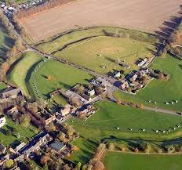
Avebury
How well do you know Avebury?

Slide 2
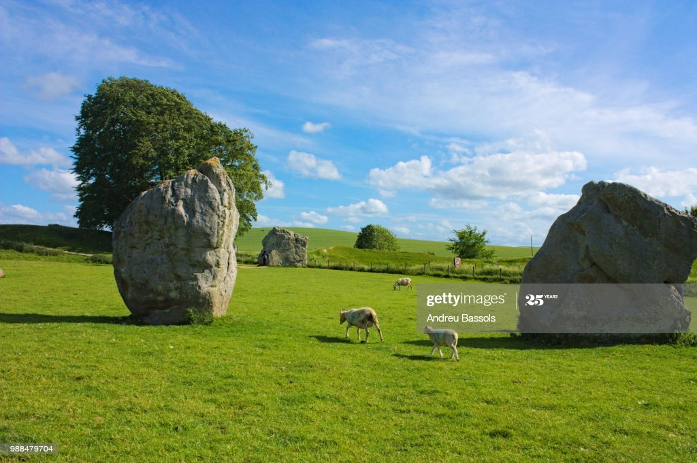
Here are some pictures of Avebury rocks

Slide 3
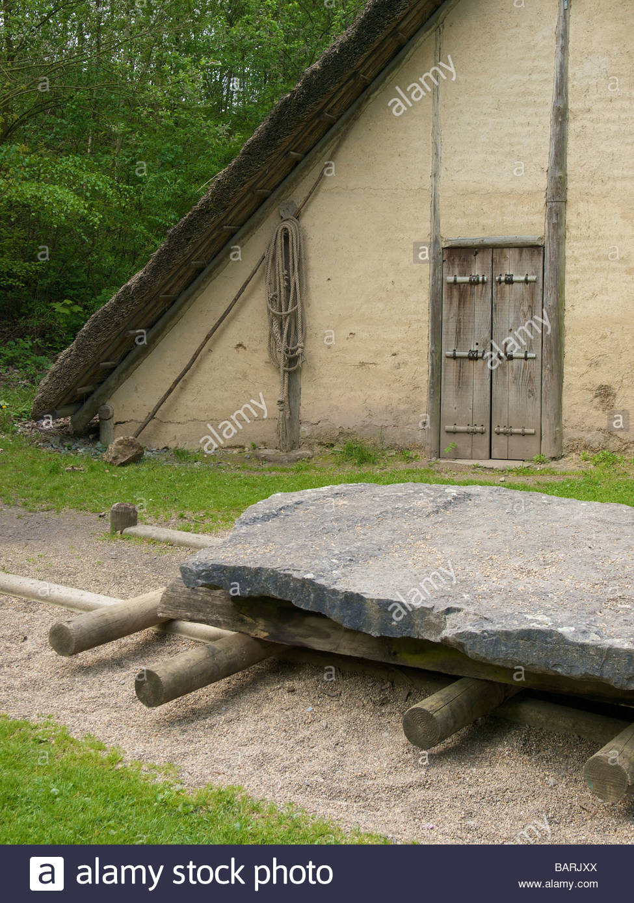
Lots of men moved rocks and logs by using rope

Slide 4
Facts
A henge is 20m tall. A henge is the big hill in Avebury.did you know A barburs skeleton was found under a rock!
By Dodi and ava

